Slide 1
EEE Lecture -15
Network Theorems

Slide 2
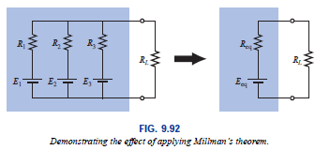
9.6 Millman’s Theorem
Through the application of Millman’s theorem, any number of parallel voltage sources can be reduced to one. In Fig. 9.92, for example, the three voltage sources can be reduced to one.
This would permit finding the current through or voltage across R_{L} without having to apply a method such as mesh analysis, nodal analysis, superposition, and so on.

Slide 3
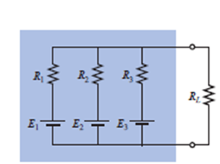
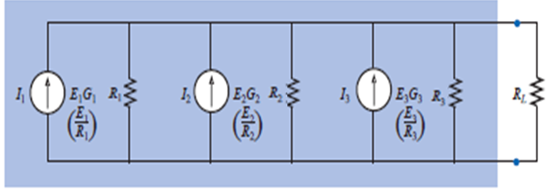
9.6 Millman’s Theorem
Basically, three steps are included in its application.
Step 1: Convert all voltage sources to current sources. This is performed in Fig. 9.93 for the network of Fig. 9.92

Slide 4

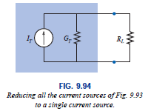
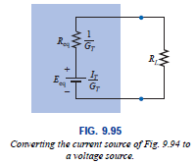
9.6 Millman’s Theorem
Step 2: Combine parallel current sources as described. The resulting network is shown in Fig. 9.94, where
I_{T} = I₁ + I₂ + I₃ and
R_{T}= R₁ || R₂ || R₃
G_{T} = G₁ + G₂ + G₃
Step 3: Convert the resulting current source to a voltage source, and the desired single-source network is obtained, as shown in Fig. 9.95.

Slide 5
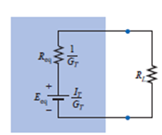
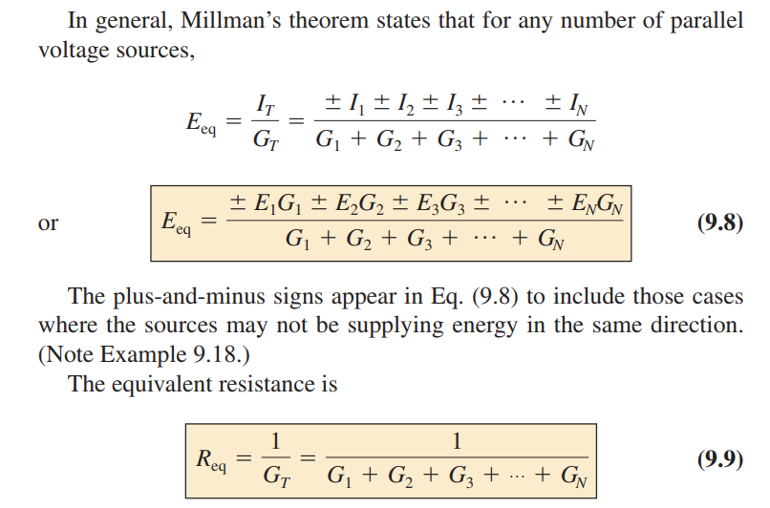
9.6 Millman’s Theorem

Slide 6
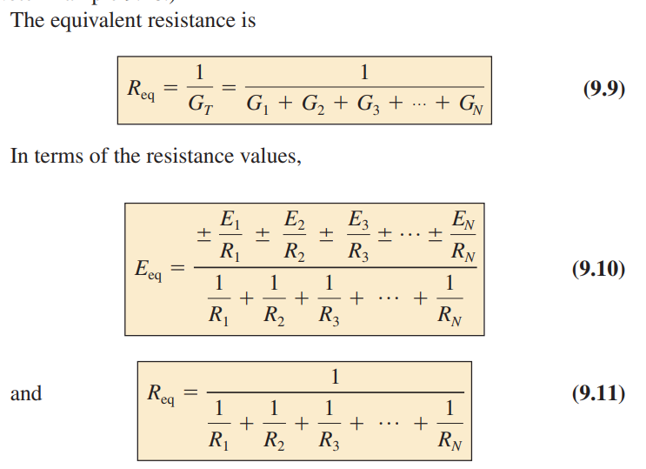
9.6 Millman’s Theorem

Slide 7
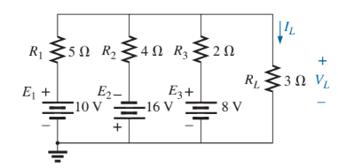
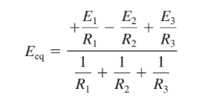
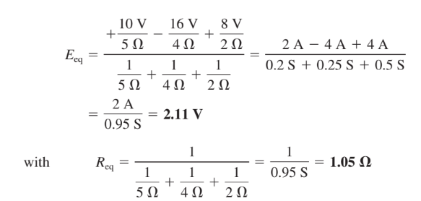

Slide 8
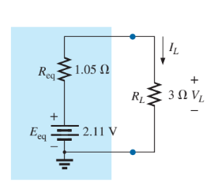
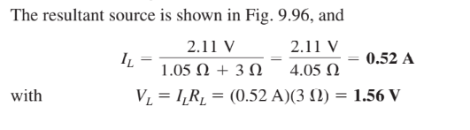

Slide 9
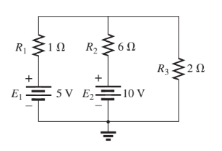
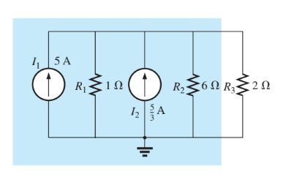
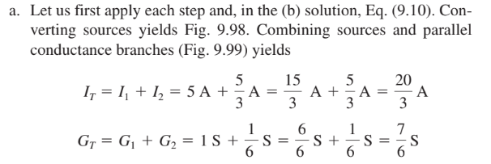

Slide 10
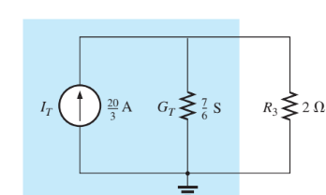
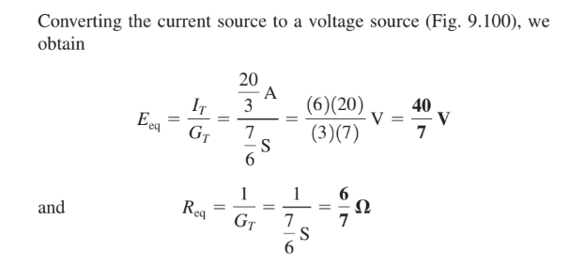
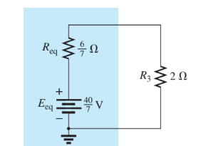

Slide 11
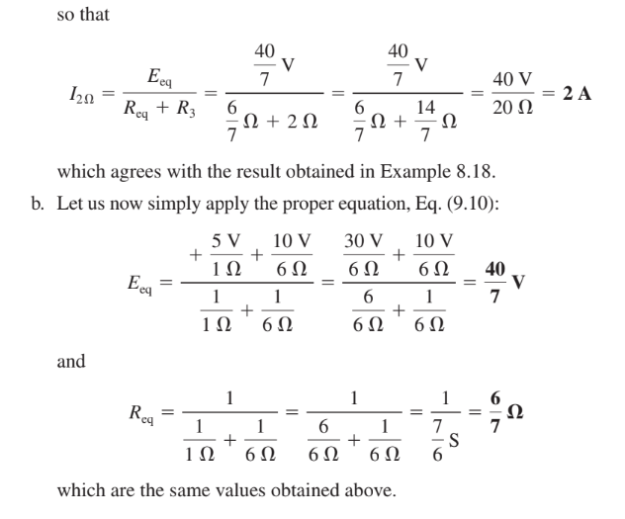

Slide 12
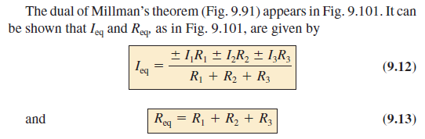
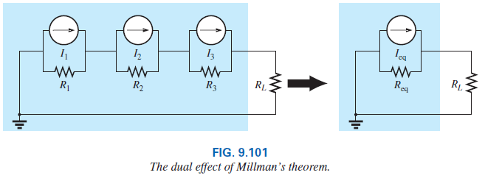
9.6 Millman’s Theorem

Slide 13
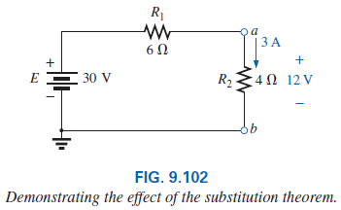
9.7 Substitution Theorem
The substitution theorem states the following: If the voltage across and the current through any branch of a dc bilateral network are known, this branch can be replaced by any combination of elements that will maintain the same voltage across and current through the chosen branch.

Slide 14
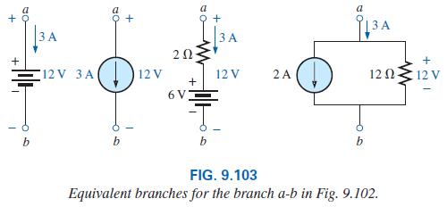
9.7 Substitution Theorem
More simply, the theorem states that for branch equivalence, the terminal voltage and current must be the same.
Consider the circuit in which the voltage across and current through the branch a-b are determined. Using the substitution theorem, a number of equivalent a-b branches are shown in Fig. 9.103.

Slide 15
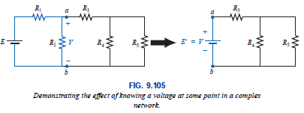
9.7 Substitution Theorem
One application of the theorem is shown in Fig. 9.105. Note that in the figure the known potential difference V was replaced by a voltage source, permitting the isolation of the portion of the network including R3, R4, and R5.

Slide 16
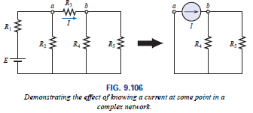
9.7 Substitution Theorem
The current source equivalence of the above is shown in Fig. 9.106, where a known current is replaced by an ideal current source, permitting the isolation of R₄ and R₅.

Slide 17
9.8 Reciprocity Theorem
The reciprocity theorem is applicable only to single-source networks (not applicable for multisource).
The theorem states the following:
The current I in any branch of a network, due to a single voltage source E anywhere else in the network, will equal the current through the branch in which the source was originally located if the source is placed in the branch in which the current I was originally measured.
In other words, the location of the voltage source and the resulting current may be interchanged without a change in current. The theorem requires that the polarity of the voltage source have the same correspondence with the direction of the branch current in each position.

Slide 18
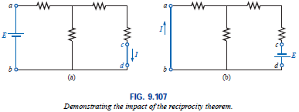
9.8 Reciprocity Theorem
In the representative network of Fig. 9.107(a), the current I due to the voltage source E was determined. If the position of each is interchanged as shown in Fig. 9.107(b), the current I will be the same value as indicated.

Slide 19
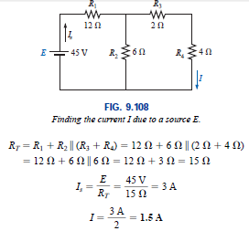
9.8 Reciprocity Theorem
To demonstrate the validity of this statement and the theorem, consider the network of Fig. 9.108.

Slide 20
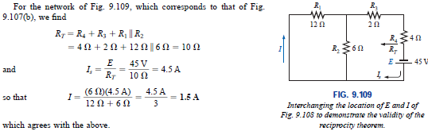
9.8 Reciprocity Theorem

Slide 21
Thank You

